Slide 1
U.S. Airport & Airline Delay Analysis
Aracely, Luis, Ronak, and Dan

Slide 2
Analysis Summary
Overview: Our project looks to analyze commercial airline flights in the US in order to summarize timeliness of arrivals, and if delayed, the primary reason(s) for this (i.e. weather, carrier, mechanical issues, etc.) including how this varies by both, airline and airport.
We’ve broken up our analysis into two main themes:
Delays by U.S. Airport
Delays by U.S. Airline
Key Questions:
What is the most delay-prone airport and airline in the U.S.?
What is the most prevalent delay cause?
What area of the country is most prone to flight delays?
Scope: 18 Airlines and the Top 25 Airports (by flight volume)
Time period: September 2018 – September 2019
Data source(s), Cleaning, and Exploration:
United States Department of Transportation, Bureau of Transportation Statistics,
Data Cleaning: renamed and removed unnecessary columns, removed airports outside of U.S., removed N/As
Google Maps (API) for Airport Lat Longs, then used gmaps for heatmapping

Slide 3
Airport Delay Analysis

Slide 4
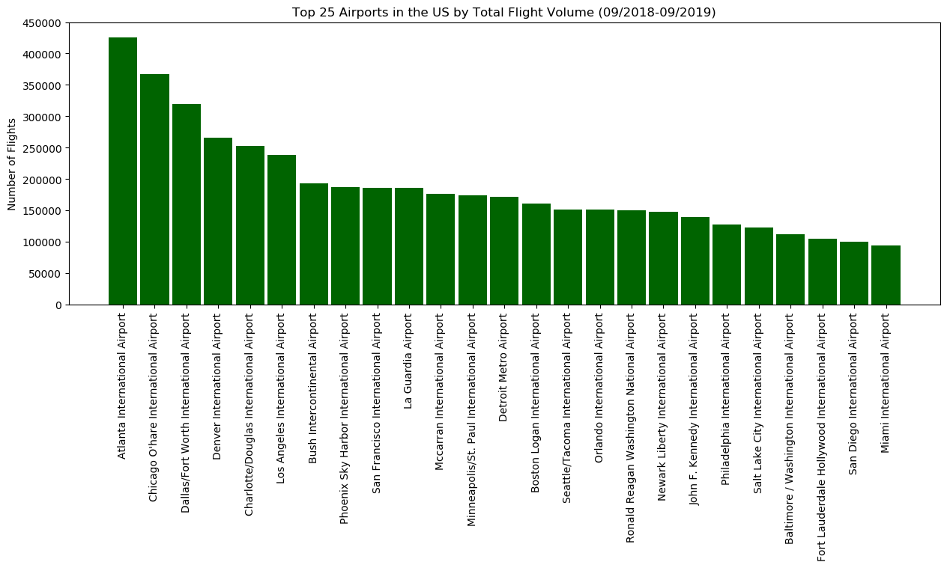
Exhibit A

Slide 5
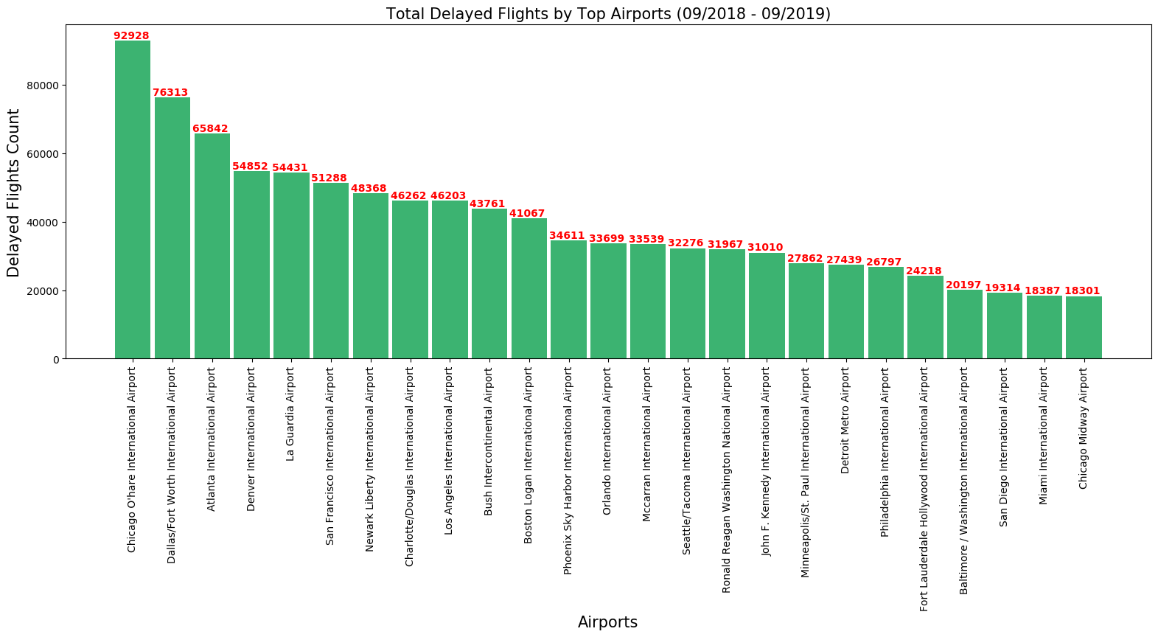
Exhibit B

Slide 6
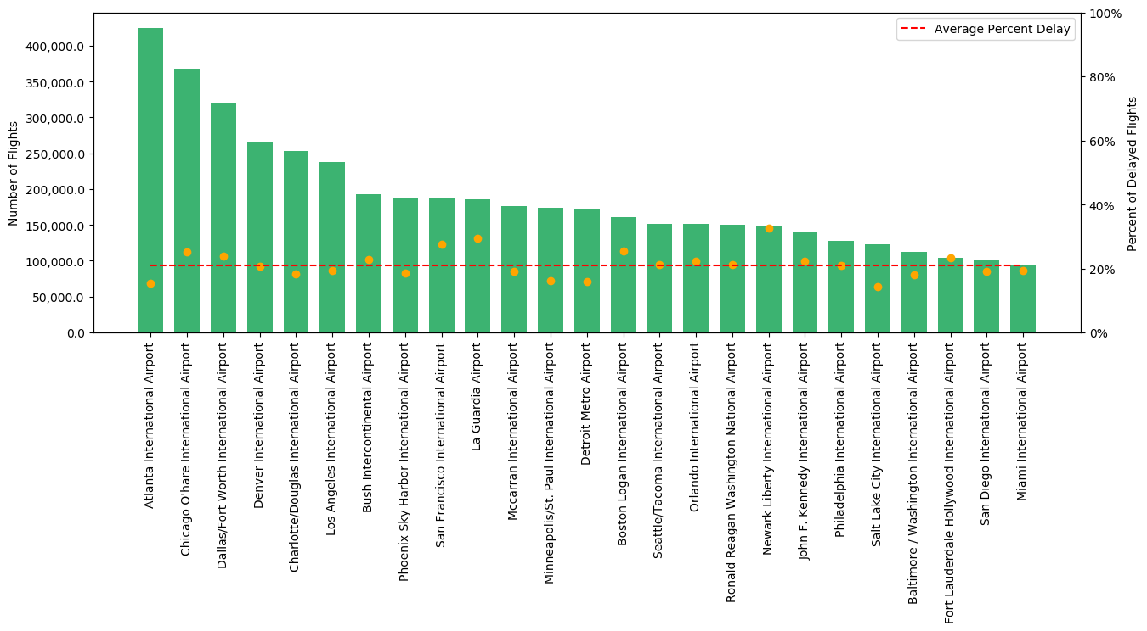
Total number of flights by top 25 U.S. airport including percentage of flight delays for each compared to the mean delay percentage.
Delay percentage
Exhibit C

Slide 7
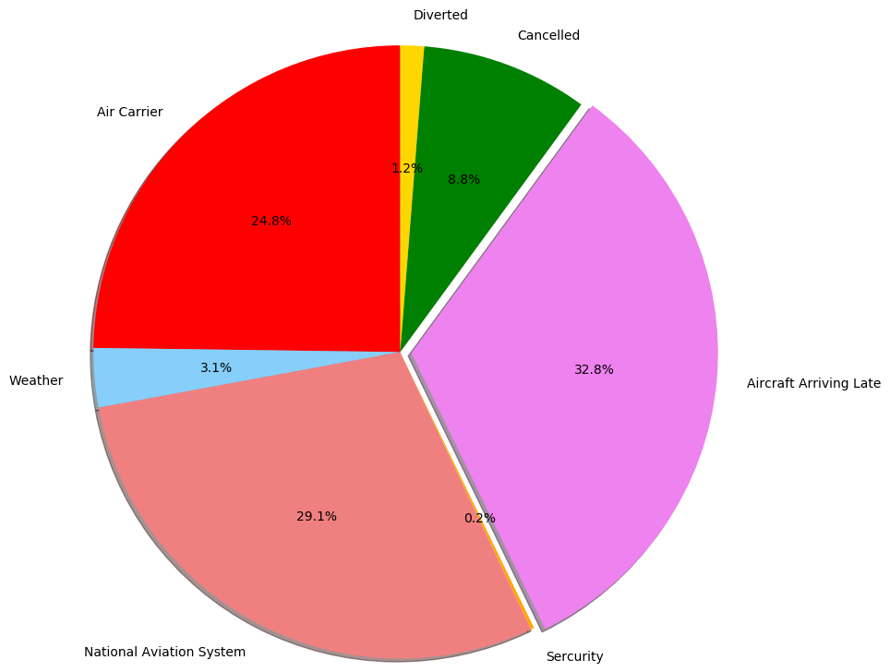
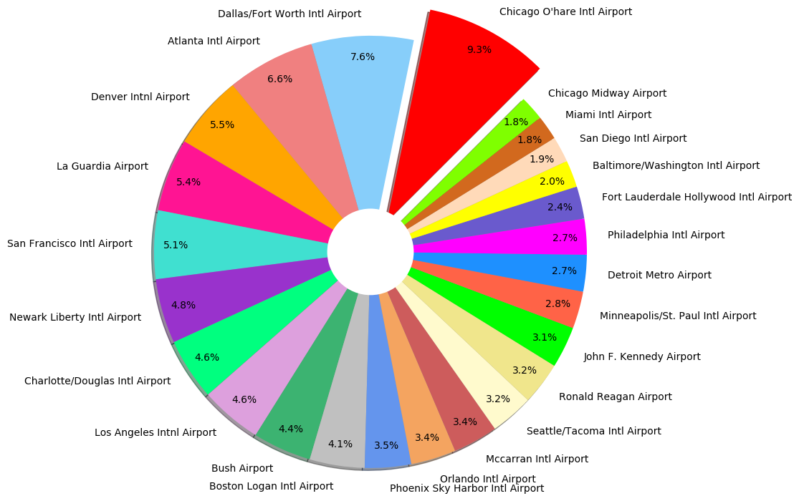
Total Delay Percentage by U.S. Airport (as % of Total)
Delay Causes as a Percentage of Total
Exhibit D
Exhibit E
1
2
¹Carrier Delay: Carrier delay is within the control of the air carrier. Examples of occurrences that may determine carrier delay are: aircraft cleaning, aircraft damage, awaiting the arrival of connecting passengers or crew, baggage, bird strike, cargo loading, catering, computer, outage-carrier equipment, crew legality (pilot or attendant rest), damage by hazardous goods, engineering inspection, fueling, handling disabled passengers, late crew, lavatory servicing, maintenance, oversales, potable water servicing, removal of unruly passenger, slow boarding or seating, stowing carry-on baggage, weight and balance delays.
²Late Arrival Delay: Arrival delay at an airport due to the late arrival of the same aircraft at a previous airport. The ripple effect of an earlier delay at downstream airports is referred to as delay propagation.

Slide 8
Airline Delay Analysis

Slide 9
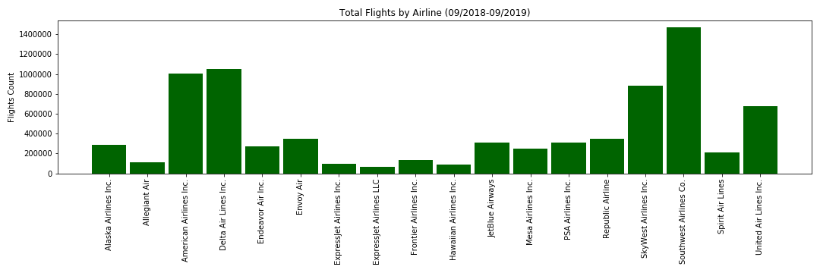
Exhibit F

Slide 10
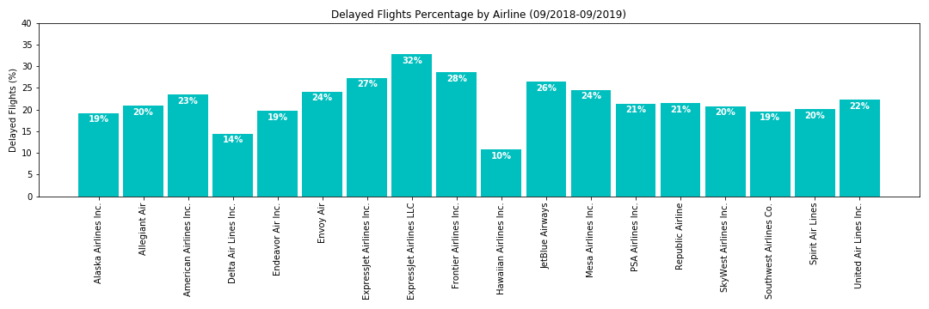
Exhibit G
Rank | Airline | Delay Count | Delay Percentage
1 | ExpressJet Airlines LLC (ManaAir / United Airlines)¹ | 21,086.17 | 32.79%
2 | Frontier Airlines Inc. | 39,393.26 | 28.60%
3 | ExpressJet Airlines Inc. (United Airlines)¹ | 26,378.96 | 27.32%
4 | JetBlue Airways | 81,252.91 | 26.39%
5 | Mesa Airlines Inc. | 60,502.04 | 24.59%
6 | Envoy Air (American Airlines)² | 83,714.10 | 24.11%
¹ExpressJet operates as United Express, on behalf of United Airlines. ExpressJet Airlines LLC is majority owned by ManaAir LLC, minority owned by United Airlines. As such, the LLC is synonymous with ManaAir LLC recognized as United Airlines. As such, United Airlines and their partners are by and large the most delay-prone.
²Envoy Air operates as American Eagle, a wholly owned subsidiary of American Airlines

Slide 11
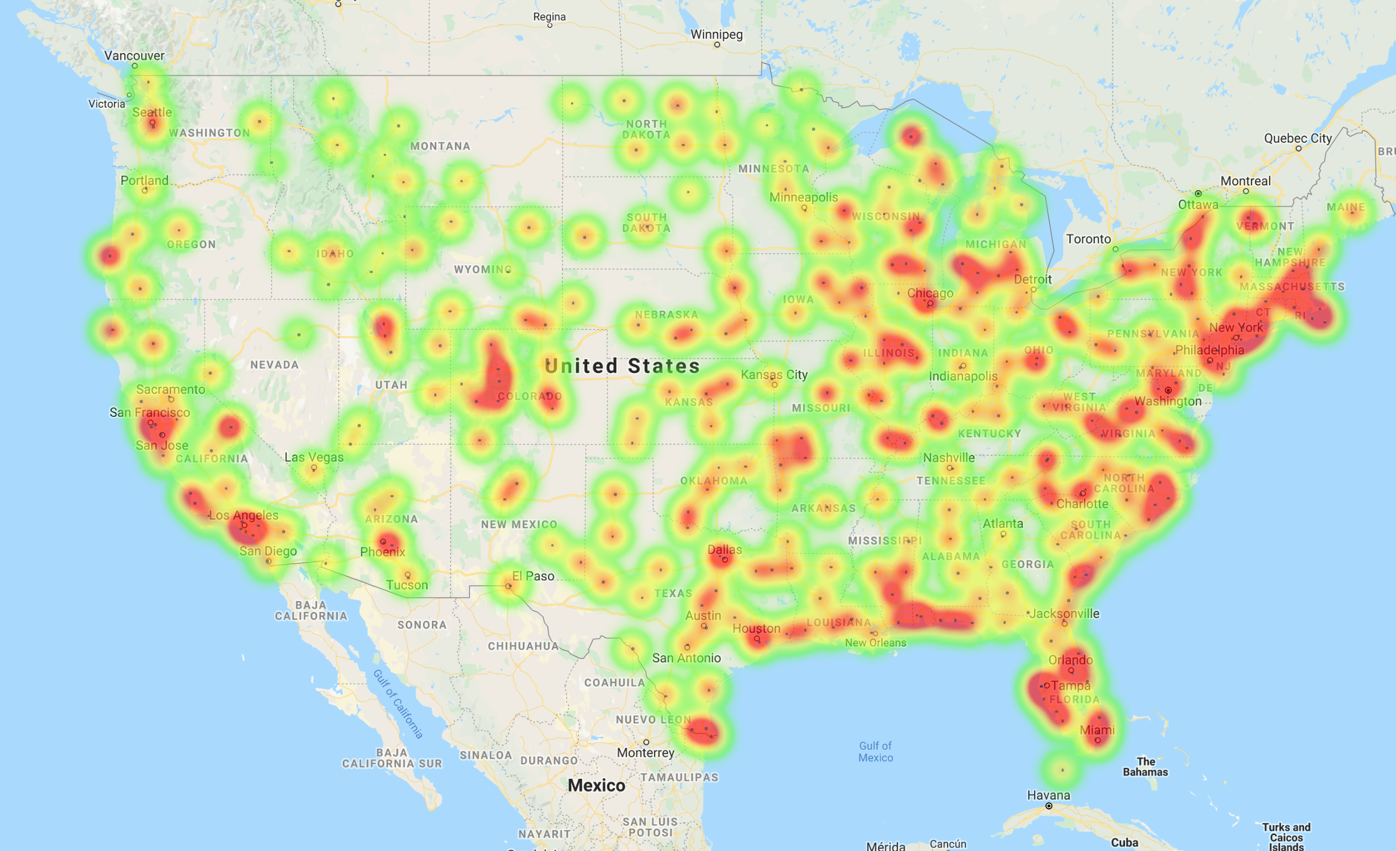
Flight Delay Heatmap – Continental U.S. (all airports)
Exhibit H

Slide 12
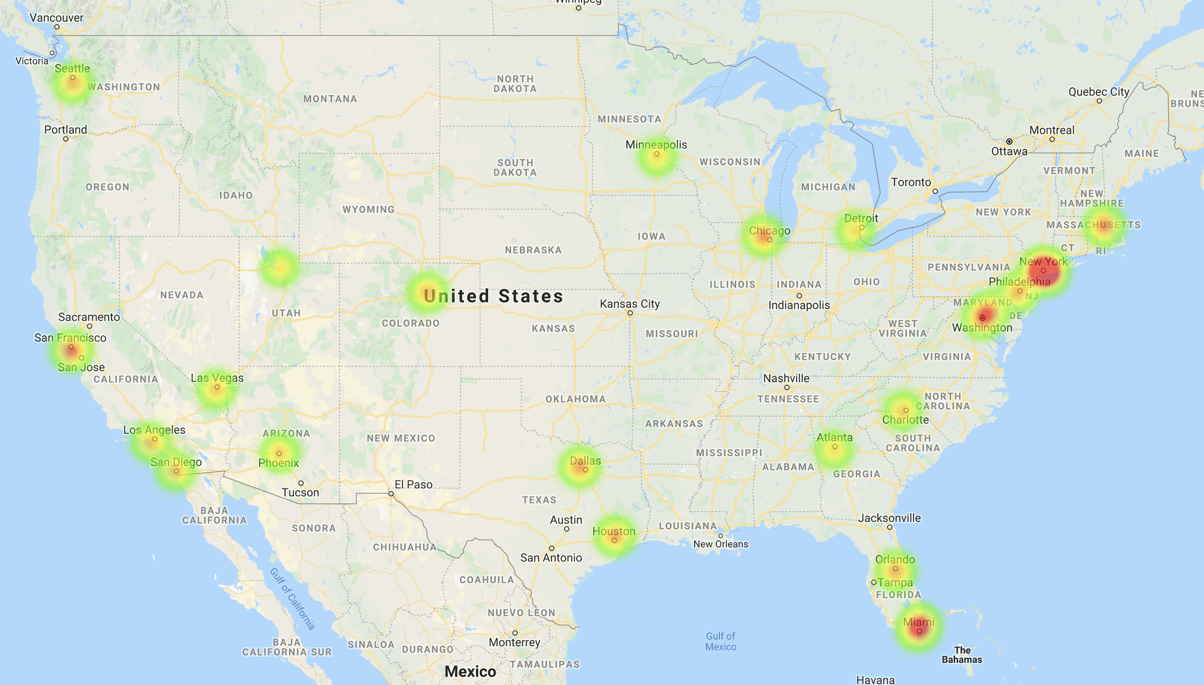
Flight Delay Heatmap – Continental U.S. (Top 25 airports)
Exhibit I

Slide 13
Conclusions (Recap)
Top U.S. Airport by Volume: Atlanta International Airport
Top U.S. Airline by Volume: Southwest Airlines
Most Delay-prone U.S. Airport (as a % of total): Newark Liberty Int’l Airport (33%, 21% average US delay rate)
Most Delayed U.S. Airline (as a % of total): Frontier Airlines¹ (28%)
Most Common Delay Cause: Aircraft Arriving Late
Based on the heatmaps, the most delay prone area of the country (U.S.) is the northeast region.
¹Per further analysis and since ExpressJet operates as United Airlines, the combined delay rate for United is actually 24% which is lower than both, Frontier and JetBlue. Making Frontier the most delayed Airline in the U.S.

Slide 14
Appendix – Code Analysis

Slide 15
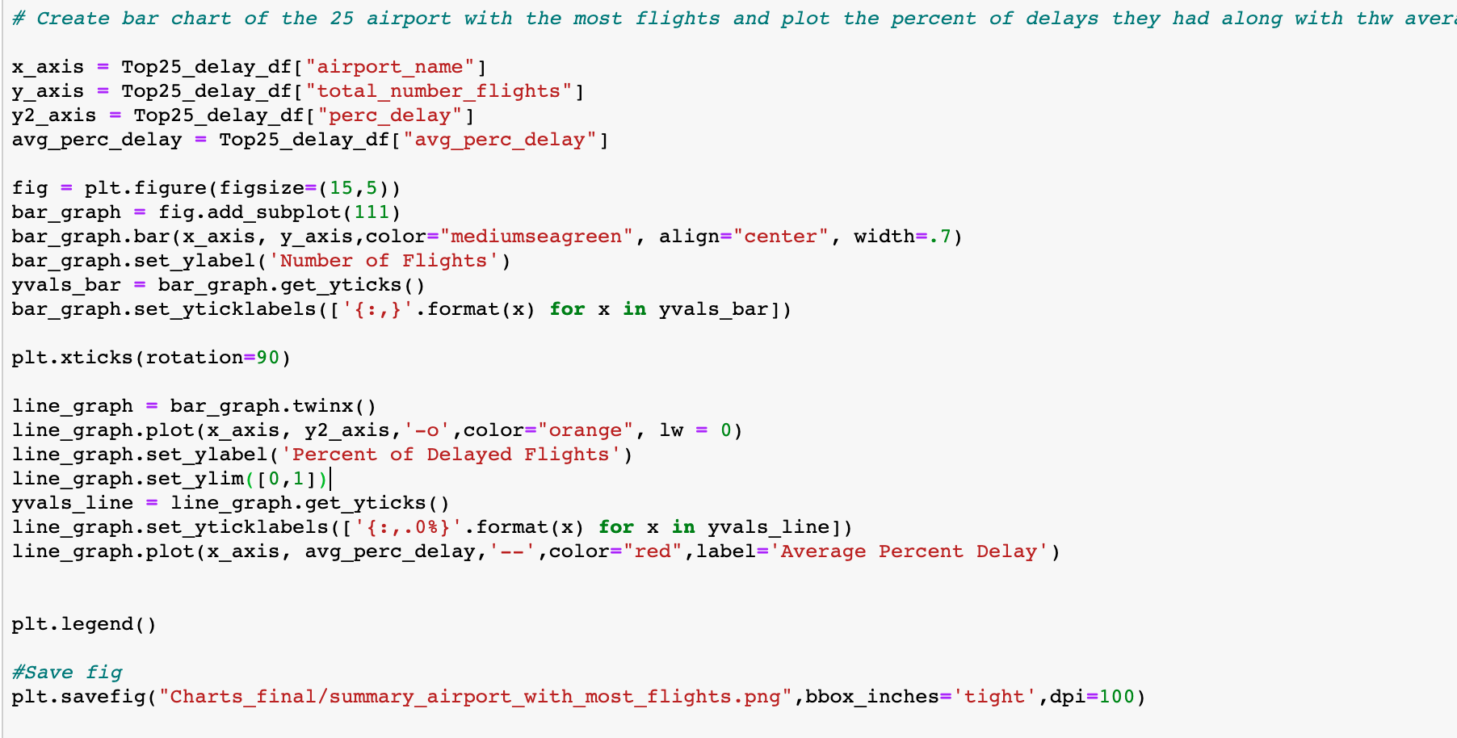

Slide 16
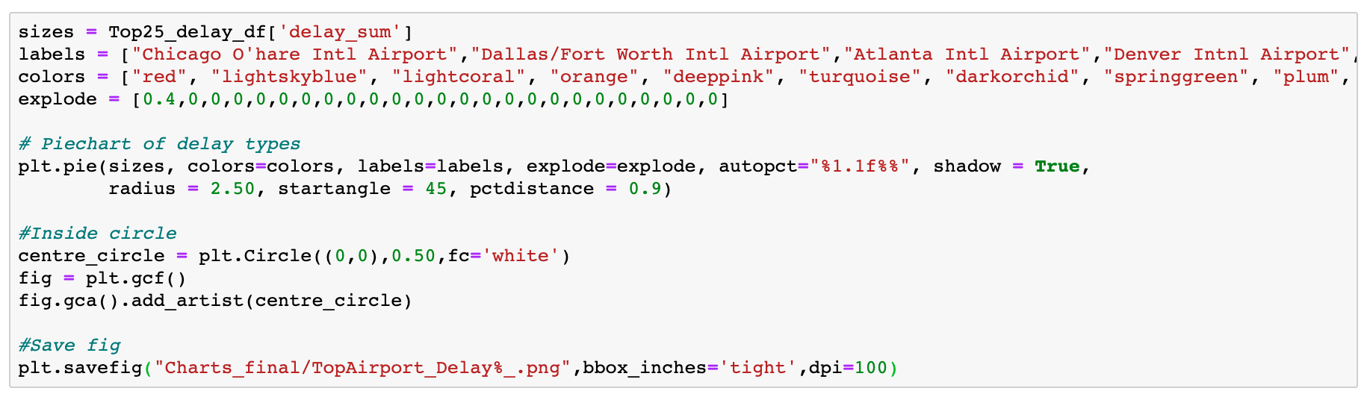

Slide 17
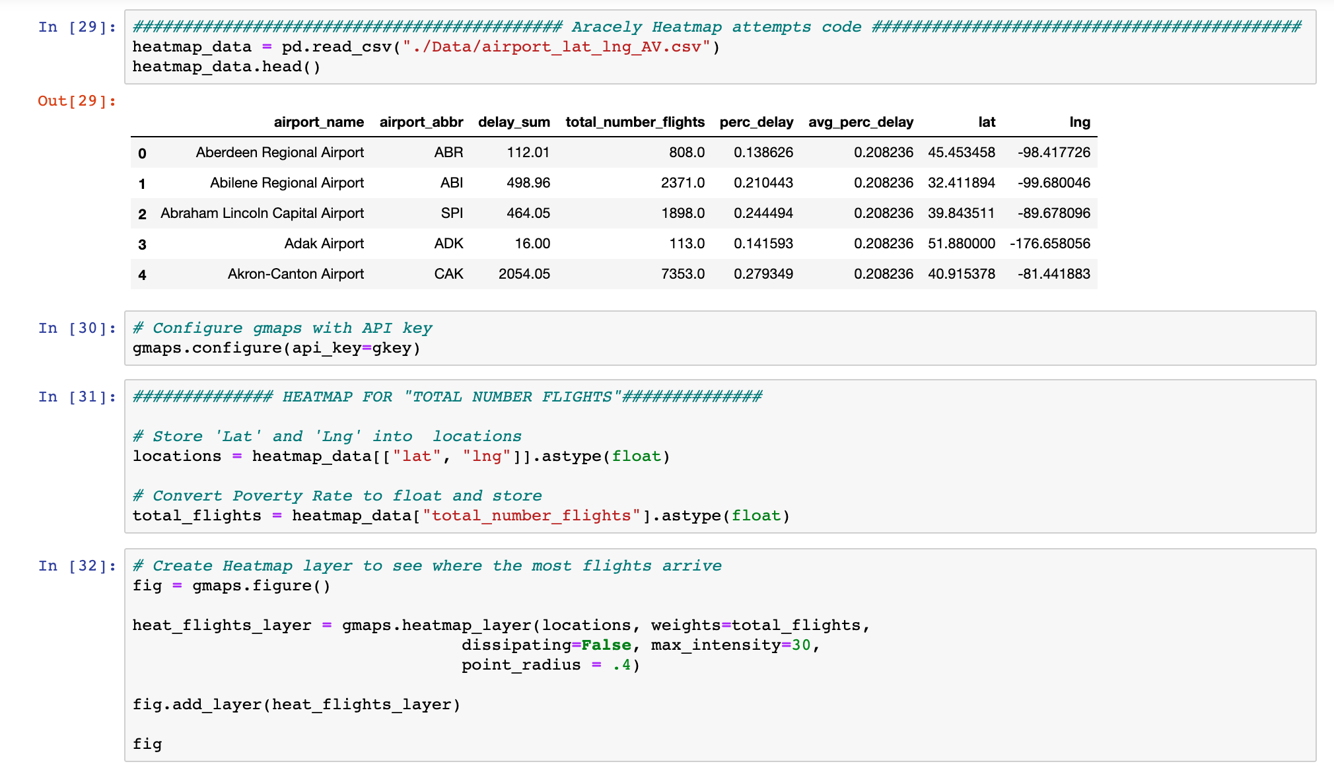

Slide 18
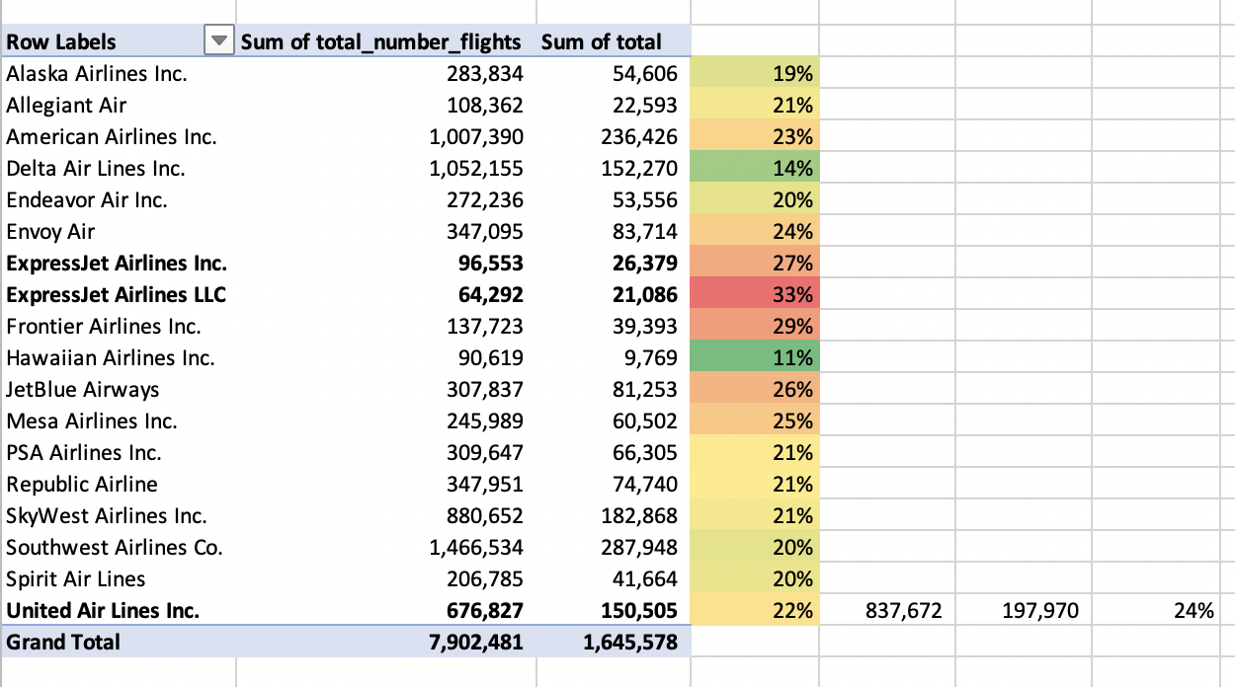
United / ExpressJet (reconciliation)

